Slide 1
INSTITUTE OF DATA Capstone
Predicting two wheelers loan defaulters
Monica Estrada
29th May 2021

Slide 2
Biography
Future Data Scientist
Certificate IV Accounting & Bookkeeping
Master in Business Administration
Master in Regional Development, Planning & Management
Bachelor Degree in Marine Biology
10+ years experience in natural resources management & budgeting, 5+ in bookkeeping
Passionate about learning & upskilling

Slide 3
Agenda
Project Context
Domain, Problem, Domain context
Define
Stakeholders, Business & Data questions, Value
Design
Data, EDA, Pipeline
Deliver
Models, Metrics
Summary & conclusions
Recap, Main findings
Further steps

Slide 4
1. Project Context - India
Finance Industry: Personal Loans
2-wheeler loan market to grow from US$7.2b (2020) to $12.3b (2025)¹⁵
Defaults on 2-wheelers 40% of total outstanding loans in 2007⁶
Bad loans ratio to increase approx. 3.5% from Mar/20 – Mar/21¹
Financers have tighten credit flow⁶
Financiers adopting stricter process to screen customers⁶
Dealers finding difficult to get banks to finance their inventory¹
Focus on customer segmentation⁵
There is no fixed score for availing a bike loan (institutions accept a score of 600+ CIBIL score range 300 to 900)⁴

Slide 5
1. Project Context
Transportation industry: Motorbikes
Global motorcycles market to grow by 5.73% from 2020 to 2027⁹
Global motorcycles sales dropped almost 30% in 1st half-20 (Covid-19)¹
Sales started bouncing back in the 3rd quarter-20¹²
2-wheelers targeted as best replace for public transport¹²
Less expensive than cars, less fuel, better mileage, better in peak hours⁴
India 2nd largest market of motorcycles¹⁰

Slide 6
1. Project Context
Problem area & importance
Increase in defaults, decrease in financing & increase in two-wheeler demand, offer and opportunity to develop more robust & trustworthy tools to assess loan applications.
Machine learning algorithms have a lot to offer when assessing credit risk (power and speed).
Value of decreasing bad loans
If total value motor loan market 2020 is US$7.2b & increase ratio on bad loans ratio 3.5% for 2021, decreasing only 20% of that ratio would represent a decrease on bad loans value on near US$504 million.

Slide 7
2. Define
Business aspects
Stakeholders
Financial institutions
Motorbikes dealers
Why do they care about this problem?
Loans are the biggest risk for financers
For financers 2 adverse events: false positives (reduce profits) & false negatives (increase risk)
Financers rules becoming more complex, more accountability for non-compliance & more automation

Slide 8
Data questions
Business question
How to assess the risk of a loan default fast and accurate?
What model could be used to predict risk of defaulting on a personal loan?
What are the main variables when assessing a loan application?

Slide 9
Original Dataset
3. Design
Clean Dataset
Split data based on target. Random subsample of majority class to equal size of minority class
Remove variables (majority values missing, highly correlated, no enough info/no clear impact)
Categorical to numerical
Final dataset: 5,228 observations, 22 features
New ratio: 50:50
119,528 observations
30 features
1 Target variable (1: Defaulters, 0:Non-Defaulters)
Highly unbalanced: 2:98 ratio (rare events)
https://www.kaggle.com/sjleshrac/tvs-loan-default
Jul/20, Tech competition

Slide 10



Pipeline
BUSINESS DOMAIN & CONTEXT
4
PROBLEM STATEMENT
BUSINESS & DATA ANSWERS
1
STAKEHOLDERS
BUSINESS QUESTION
EDA
MODELLING
2
DATA QUESTION
DATA
FEATURE ENGINEERING
COMMUNICATE
3
DATA SCIENCE PROCESS

Slide 11
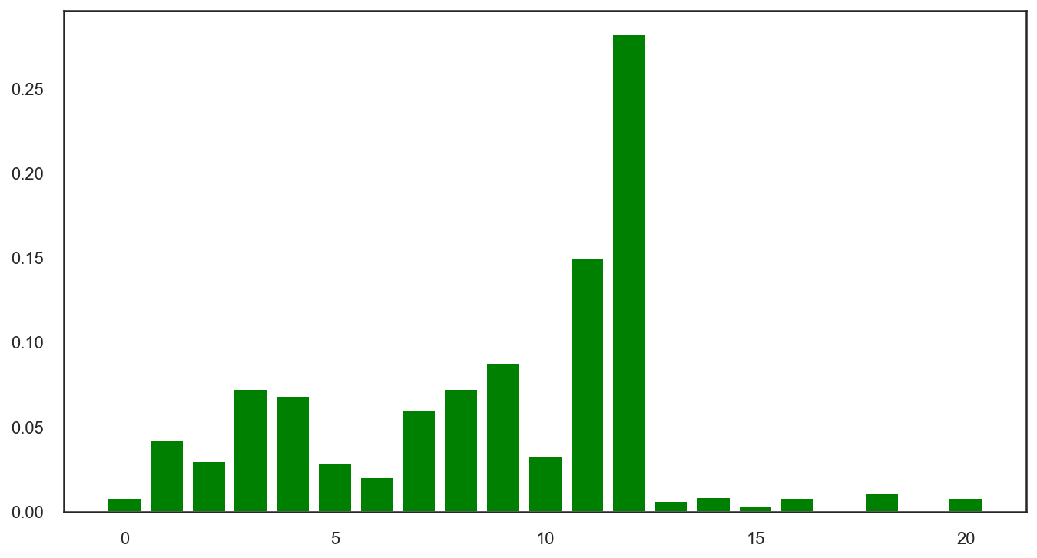
Random Forest Classification Feature importance
EDA
Feature | Name | Score
12 | Number of times 30 days past due in last 6 months | 0.28208
11 | Maximum amount sanctioned for any Two wheeler loan | 0.14954
9 | Number of loans | 0.08803
3 | EMI (Equated Monthly Instalments) | 0.07263
8 | Customer age when loan taken | 0.07243
4 | Loan Amount | 0.06834
7 | Interest rate | 0.06009
1 | Number times bounced 12 months | 0.04237
 | TOTAL | 0.83551

Slide 12
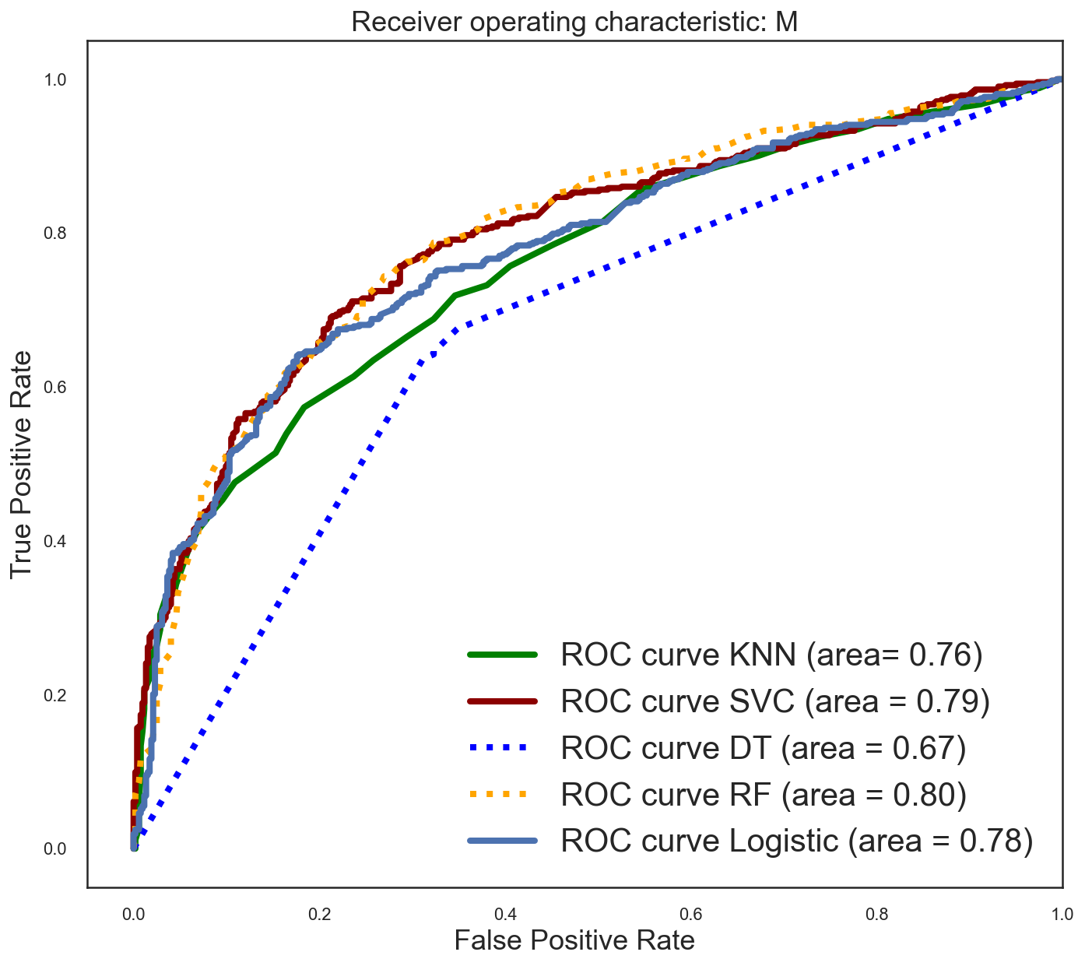
4. Deliver - Machine Models
Receiving Operating Characteristic

Slide 13
4. Deliver: Models & Metrics
 | METRICS | Boosted Logistic Regression | Random Forest
Metrics Default Hyper-parameters | Cross-validation | 74.10% | 75.39%
 | Accuracy | 72.75% | 72.66%
 | Recall | 62.52% | 69.98%
 | Precision | 78.61% | 73.94%
 | F1-Score | 69.65% | 71.91%
Metrics Optimized Hyper-parameters | Cross-validation | 74.99% | 77.52%
 | Accuracy | 74.38% | 74.67%
 | Recall | 73.81% | 69.98%
 | Precision | 74.66% | 77.22%
 | F1-Score | 74.23% | 73.42%

Slide 14
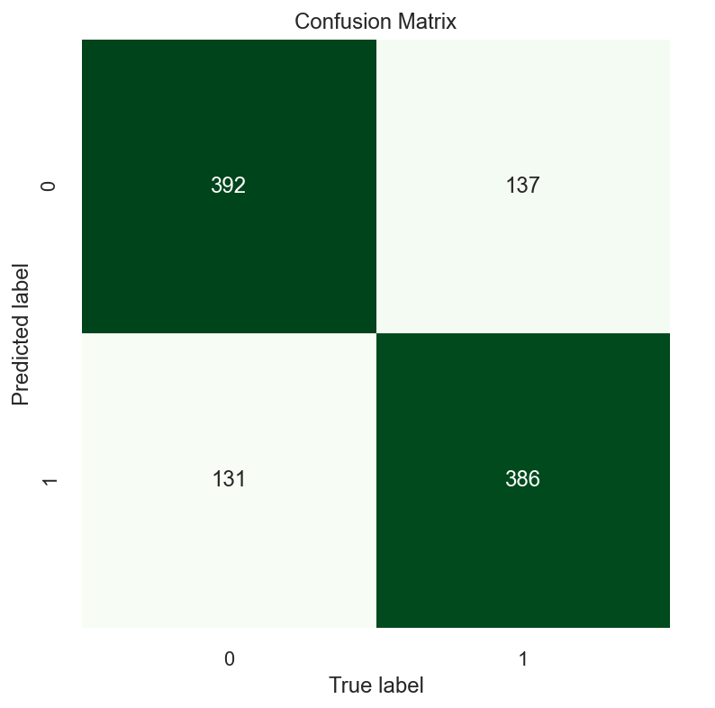
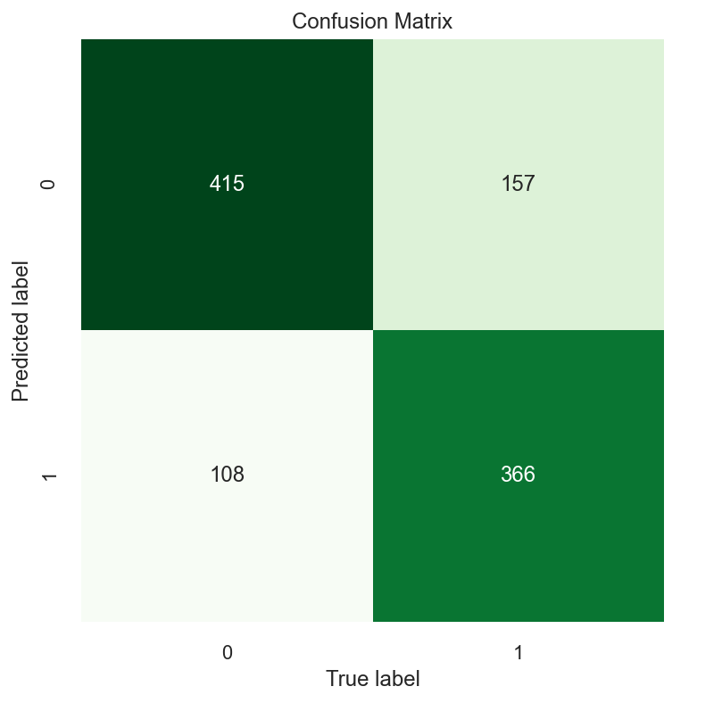
Confusion matrix
Boosted Logistic Regression
Random Forest
TN | FN
FP | TP

Slide 15
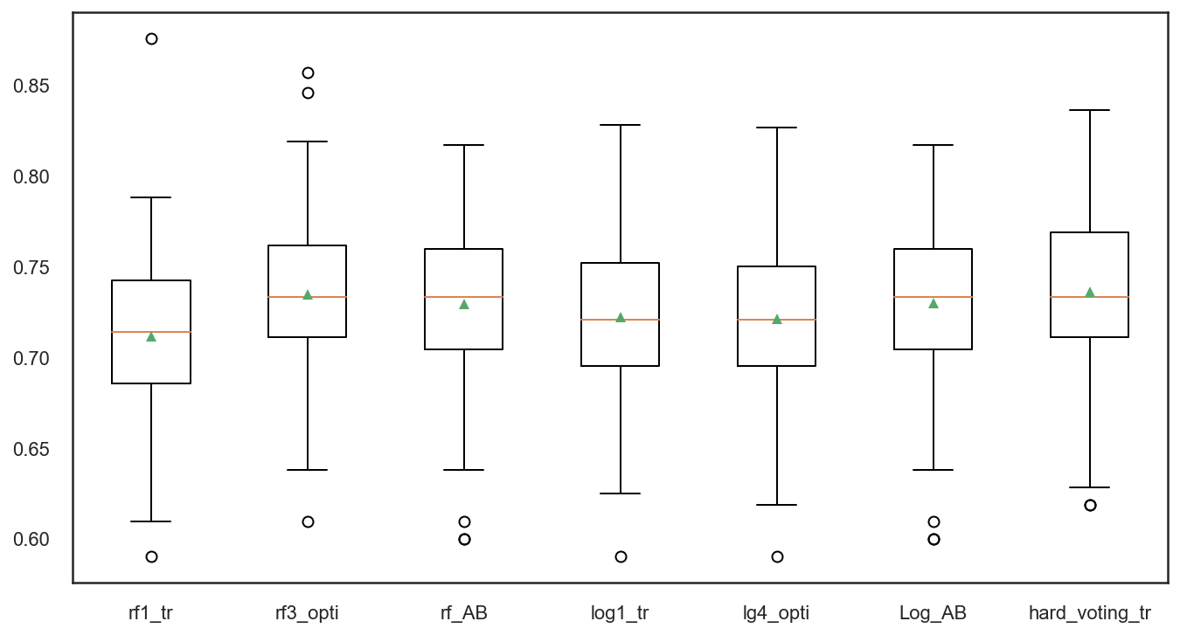
VOTING RESULTS ON TEST
Random Forest with optimized hyper-parameters. Average accuracy 73.5%
Boosted Logistic Regression with optimized hyper-parameters. Average accuracy 73.0%

Slide 16
5. Summary & Conclusions
How to assess the risk of a loan default fast and accurate?
Machine learning models can offer a solution.
However classification of imbalanced data with many outliers are a challenge.
What model could be used to predict risk of defaulting on a personal loan and what are the metrics?
Two models (using optimized parameters) can predict the risk with similar metrics:
Random Forest & Boosted Logistic Regression
Based on accuracy
Random Forest = 74.67%
Boosted Logistic Regression = 74.38%
Based on F1-score (trade-off between recall & precision)
Random Forest = 73.42%
Boosted Logistic Regression = 74.23%
Notes:
Random Forest with optimized hyper-parameters: Pros: Robust to outliers; lower risk of overfitting, runs efficiently on a large dataset, better accuracy, work well with categorical & numerical data, can handle linear and non linear relationships, good performance on imbalanced datasets. Cons: complex and computational expensive.; it is not easy interpretable, little control over what the model does (black box algorithm)

Slide 17
5. Summary & Conclusions
MODEL SELECTED:
Boosted Logistic Regression
Pros:
stable, simpler, easier to implement and interpret, efficient to train, uses less computational power. Very popular and is used when target is categorical. It is easy to convert the model result to a specific strategy and deploy.
Cons:
easy to under-fit, high demand for data, not to good at dealing with unbalanced data, high-dimension feature set, and categorical features.
Boosting:
makes the model more robust and stable, improves accuracy, but reduce interpretability.

Slide 18
5. Summary & Conclusions
What are the main variables to look up when assessing a personal loan application?
Number times 30 days past due in last 6 months,
Maximum amount sanctioned for any Two wheeler loan,
Number of loans,
EMI (Equated Monthly Instalments),
Customer age when loan taken,
Loan Amount ,
Interest rate, &
Number times bounced 12 months

Slide 19
6. Next steps
Model performance could be improved with more rich data (especially from defaulters, minority class).
More domain knowledge to deal with outliers. Data outliers can spoil and mislead the training process resulting in longer training times, less accurate models & ultimately poorer results.
Domain knowledge would help in assessing which outliers should be kept, which removed and/or which to change for another variable.
Use penalized models to impose an additional cost on the model for making classification mistakes on the minority class during training to assess performance improvement.

Slide 20
References
¹² https://www.motorcyclesdata.com/2020/12/22/world-motorcycles-market/
⁶ https://timesofindia.indiatimes.com/business/india-business/two-wheeler-loan-defaults-on-the-rise/articleshow/2423112.cms
¹ https://www.moneycontrol.com/news/technology/auto/this-week-in-auto-banks-unwilling-to-lend-to-two-wheeler-buyers-over-default-fears-5947271.html
⁵ https://www.crisil.com/mnt/winshare/Ratings/RatingList/RatingDocs/WheelsEMI_Private_Limited_April_08_2019_RR.html
⁴ https://www.coverfox.com/cibil/cibil-score/cibil-score-for-bike-loan/
⁹ https://www.marketresearchfuture.com/reports/motorcycles-market-10217
¹⁵ https://finance.yahoo.com/news/market-trends-developments-indias-two-114500571.html
¹⁰ https://www.marketresearchfuture.com/reports/motorcycles-market-10217

Slide 21

THANK YOU
ANY QUESTIONS?

